Slide 1
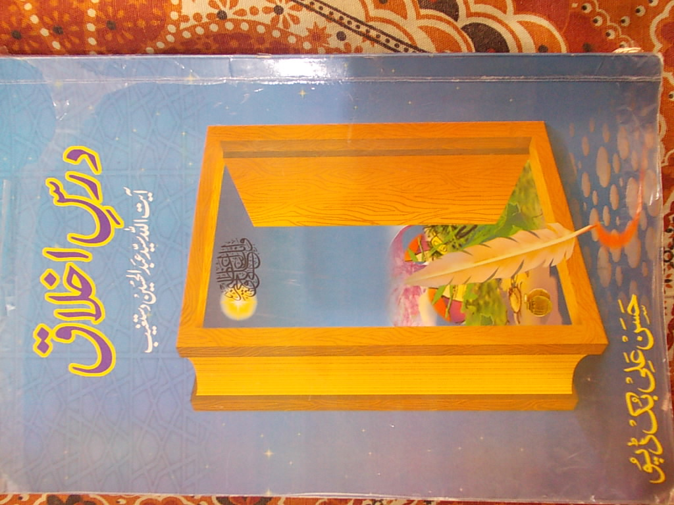
Ayatullah
Dastagheeb

Slide 2
About book
Naam : Dars-e-Ikhlaaq
Mauallif : Ayatullah Dastagheeb
Tarjuma : Asad Ali
Asha’at : 2003
Ayatullah Dastagheeb k dia howay dars….

Slide 3
Introduction
Ikhlaaq
Taleem say pehlay
“Un ki misaal us gadhay ki tarhan hy jis pr bari bari
kitabain ladi hon” (soora-e-jumma “5’)
Achay or buray ikhlaaq ki tameez
Ayatullah Dastagheeb or dars-e-ikhlaaq

Slide 4
1st, 2nd dars
Rukawat na bnay
Waqia-e- Mehmood o Ayaz
Ghaflat aik bala
Aqal ki quwwat
Khaliq or makhlooq
Lalach
Aik waqia

Slide 5
3rd, 4th dars
Insaan ko khud apni maarfat honi chahye
Aakhirat mein seerat k mutabiq soorat hogi
Duniya aakhirat ki kheti
Khuda k ehsanaat (dard ka ehsaas, nakhun etc.)
Ehsaas-e-naymat

Slide 6
5th, 6th dars
Maarfat par ayteraaz
Un k paas daleel nahi
Aadat aik dam say nahi banti
Farmaan e Imam Ali
Ghazab ki quwwat, kya krain?
Aik waqia
Azam ki quwwat

Slide 7
7th, 8th dars
Kabhi ghussa zarori hai !
Imam sajjad ka kirdaar
Bachnay ka tariqa
Myanaravi
Doosron say ehtraam ki tawaqqa

Slide 8
9th, 10th dars
Har cheez darmiyani had mein
Zameen mein namazi dhans gaya
Ta’assub shariat ky khilaaf hy
Burai ka jawab naiki
Pursukoon rehna

Slide 9
11th, 12th, 13th dars
Hasad or emaan
Haasid qazi
Takabbur
Khuda bayniyaaz hy
Takabbur ghunahon ka sabab
Hukum chalatay rehna ghalat hy

Slide 10
conclusion
Khuda ki makhlooq janwar bhi hain or insaan bhi, farq ikhlaaq ka hy.
Ghour karnay say acha ikhlaaq waazaih hojata hy
Is ko apnanay k lia mashq ki zarorat hy.
-------xxxxxxxxxx----------xxxxxxxxxx-----------

